Slide 1


Slide 2
Dendrograms: Hierarchical Clusters
Which two are most similar? What approximate value would “connect” the two?
Real Rainfall Data
City | Annual Rainfall (in)
Portland | 43.5
Boston | 43.8
New Orleans | 62.7

Slide 3
Dendrograms: Hierarchical Clusters
Rainfall Data as a Dendrogram
63
44
Boston
Portland
New Orleans
Boston & Portland are a cluster at height ~44, losing precision to create the cluster.

Slide 4
Dendrograms: Hierarchical Clusters
Visualizes hierarchical data. For text, the frequency distances are calculated to create the hc object.
Real Rainfall Data
Rainfall Data as a Dendrogram
63
City | Annual Rainfall
Portland | 43.5
Boston | 43.8
New Orleans | 62.7
44
Boston
Portland
New Orleans

Slide 5
Dendrograms: Hierarchical Clusters
Keep in Mind a Dendrogram
Rainfall Data as a Dendrogram
Reduces information much like average is a reduction of many observations’ values
Word clusters emerge often showing related terms/phrases
Term frequency is used to construct the word cluster. Put another way, term A & term B have similar freq. distances & are considered a cluster
63
44
Boston
Portland
New Orleans

Slide 6
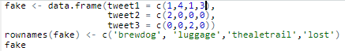
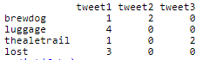
Distance Matrix
The default is to use the Euclidean distance although others i.e. Manhattan can be explored.
Fake TDM

Slide 7

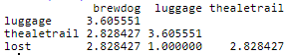
Distance Matrix
The result is a symmetrical matrix of distances (1/2) is blank bc redundant.
Fake TDM

Slide 8
Distance Matrix
Fake TDM
Tweet1: “thealetrail” = 1; “lost” = 3; (3-1) = 2
Tweet2: “thealetrail” = 0; “lost” = 0; (0-0) = 0
Tweet3: “thealetrail” = 2; “lost” = 0; (2-0) = 2
Calculation:
sqrt(2) + sqrt(0) + sqrt(2) = 1.41 + 0 + 1.41 = 2.82

Slide 9
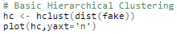
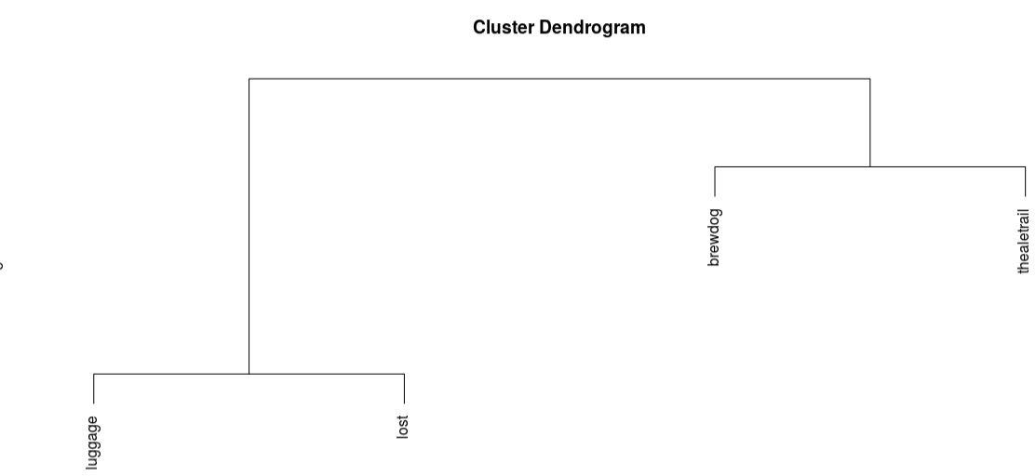
Distance Matrix
Fake TDM
Lost luggage has low distances meaning they are together a lot. Thus lower is smaller distances.

Slide 10
Open C_Dendrograms_WordNetworks.R

Slide 11
Words as association networks

Slide 12
Networks…for people
Social network analysis is a distinct line of study, but can be applied to word “association”
Tom
Edge
Jim
Node
Sue
Jen

Slide 13
Networks…for words
Social network analysis is a distinct line of study, but can be applied to word “association”
London
Edge
British Airways
Node
Beer
AleTrail

Slide 14
Word Networks…Social Network Analysis
Always hard to interpret, what terms are associated with the initial string at varying degrees of separation. i.e. associations of associations
word_associate(assocText,
match.string = 'brewdog',
stopwords = networkStops,
network.plot = T,
cloud.colors = c('black','darkred'))

Slide 15
Word cloud of Term Associations
Since its hard to read (often) a simple word cloud of associated terms can be used but loses the 2nd + order associations.
word_associate(assocText,
match.string = 'brewdog',
stopwords = networkStops,
wordcloud = T,
cloud.colors = c('black','darkred'))

